Slide 1

Asian Monsoon Flood Analysis: Hydrological & Environmental Drivers of Regional Inundation
Sprint Review & Risk Stratification Dashboard
Presenter Info: Devaraj R / AF05248523 / 21.09.2026

Slide 2
Executive Summary & Project Objectives
Context: Extreme monsoon cycles present severe flood vulnerabilities across critical Southeast Asian river basins.
Project Goal: Build an end-to-end analytical workflow combining ETL pipelines, database querying, and Power BI dashboards to quantify and monitor flood triggers.
Core Finding: While mean river discharge remains stable across regions, man-made factors (urbanization and forest loss) serve as the primary multipliers of localized flood hazards.

Slide 3

Dataset Architecture & Technical Pipeline
Data Scale: 15,000 observations across 6 monitored transboundary river basins.
Core Metrics: Hydrological flow, monsoon burst intensity, urban impervious coverage, deforestation rate, and historical flood occurrence flags.
Tech Stack:
  Storage & Querying: AWS Athena / S3 data lake.
  Transformations & DAX: Custom Power BI calculated measures for risk stratification.
  Front-End: Interactive analytical executive dashboard.

Slide 4
Key Performance Indicators (KPI Overview)
Total Records Analyzed: 15K historical observations.
Total Documented Inundations: 1K critical flood events.
Hydrological Baseline: 2.62K average discharge flow rate.
Baseline Event Likelihood: 0.50 average flood probability (balanced historical distribution).
Runoff Multiplier: 2.29 Deforestation Impact Ratio (forest loss more than doubles local runoff velocity).

Slide 5
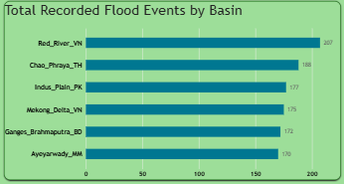
Regional Risk Hotspot Stratification
High-Risk Zones:
Red River (VN): 207 events (highest regional concentration).
Chao Phraya (TH): 188 events.
Moderate to Stable Zones:
Indus Plain (PK): 177 events.
Mekong Delta (VN): 175 events.
Ganges-Brahmaputra (BD): 172 events.
Ayeyarwady (MM): 170 events.
Visual: Bar chart showing descending event volume by basin (Total Recorded Flood Events by Basin).

Slide 6
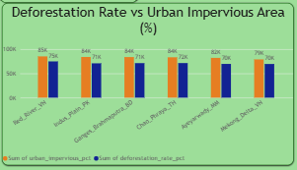
Deep Dive: Environmental & Anthropogenic Multipliers
Urban Concrete Footprint: Urban impervious coverage consistently exceeds deforestation rates across all basins, peaking at 85K in Red River and 84K in Chao Phraya.
Runoff Saturation: Paved city land prevents ground absorption, accelerating storm runoff into major river channels.
Upstream Forest Impact: The 2.29 Deforestation Impact Ratio indicates degraded tree cover eliminates natural water retention upstream.
Visual: Clustered column visual (Deforestation Rate vs Urban Impervious Area).

Slide 7
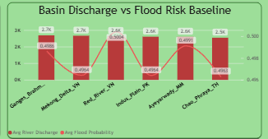
Hydrological Baselines vs Flood Probability
Discharge Invariance: Mean discharge remains steady between 2.5K and 2.7K across all monitored basins.
Key Finding: Disaster probability peaks (spikes up to ~0.500) are not driven by regular discharge averages, but by flash precipitation overwhelming urban drainage bottlenecks.
Visual: Combo dual-axis chart (Basin Discharge vs Flood Risk Baseline)

Slide 8

Strategic Recommendations & Action Plan
Urban Infrastructure: Prioritize permeable pavements, runoff retention zones, and upgraded pumping stations in Hanoi (Red River) and Bangkok (Chao Phraya).
Targeted Reforestation: Establish upstream catchment forest barriers to reverse the 2.29x runoff multiplier.
Early Warning Integration: Deploy sensor networks to track discharge spikes above the 2.62K mean baseline rather than monitoring seasonal averages alone.

Slide 9

Conclusion
Main outcomes:
Regional flood patterns were visualized.
River discharge was compared across basins.
Flood probability was analyzed.
Environmental indicators were compared.
An interactive dashboard was developed for easier decision-support and exploration.

Slide 10
Future Scope
Future Improvements
You can mention:
Add real-time weather data
Add rainfall forecasting
Add geographic maps
Add historical year-wise comparison
Add satellite-based land-use information
Develop flood-risk prediction models
Add automated Power BI refresh

Slide 11
Thank You
Any Questions?
Presented by
Deva Raj
Email: rdevaraj3469@gmail.com
LinkedIn: www.linkedin.com/in/devarajraja/
GitHub: https://github.com/rdevaraj3469-doomstay/HR-Analyst-Dashboard

